Slide 1
05 - Morphological representation and processing
Nick Riches
Introduction
05 - Morphological representation and processing
The big debate
Comp. versus Lex.
Evidence for comp. sys.
Productive usage
Morph errors
Morpho-phon. parsing
Phonotactic evidence
Nick Riches
Whole-wd. storage
Non-word roots
Multiple meanings
Psycholinguistic evidence
Newcastle University
A hybrid view
Evidence for 2 sys. Gradient phenomena
October 30, 2019
Dual Route Model
Proc. vs. Decl. The model Evidence
Crit. of DR model
(1) Pseudo-regularity
(2) The role of frequency
5-minute exercise
Bib
1 / 30

Slide 2
05 - Morphological representation and processing
Introduction
Nick Riches
Introduction
The big debate
The big debate
Comp. versus Lex.
Evidence for a computational system
Evidence for comp. sys.
Productive usage
Morph errors
Morpho-phon. parsing
Phonotactic evidence
Evidence of the whole-word storage of morphologically-complex words
Whole-wd. storage
Non-word roots
Multiple meanings
Psycholinguistic evidence
A hybrid view
Morphology in language impairments - Ullman and Pinker’s Dual Route model
5-minute exercise Bibliography
A hybrid view
Evidence for 2 sys. Gradient phenomena
Dual Route Model
Proc. vs. Decl. The model Evidence
Crit. of DR model
(1) Pseudo-regularity
(2) The role of frequency
5-minute exercise
Bib
1 / 30

Slide 3
05 - Morphological representation and processing
Nick Riches
Introduction
The big debate
Comp. versus Lex.
Look at these examples. What does the suffix ‘mouth’ mean? How do you pronounce it in each word?
Evidence for comp. sys.
Productive usage
Morph errors
Morpho-phon. parsing
Phonotactic evidence
Portsmouth
Plymouth
Tynemouth
Grangemouth
Cockermouth
Whole-wd. storage
Non-word roots
Multiple meanings
Psycholinguistic evidence
A hybrid view
Evidence for 2 sys. Gradient phenomena
Dual Route Model
Proc. vs. Decl. The model
Evidence
Crit. of DR model
(1) Pseudo-regularity
(2) The role of frequency
5-minute exercise
Bib
2 / 30

Slide 4
05 - Morphological representation and processing
Introduction
Nick Riches
Introduction
The big debate
The big debate
Comp. versus Lex.
Evidence for a computational system
Evidence for comp. sys.
Productive usage
Morph errors
Morpho-phon. parsing
Phonotactic evidence
Evidence of the whole-word storage of morphologically-complex words
Whole-wd. storage
Non-word roots
Multiple meanings
Psycholinguistic evidence
A hybrid view
Morphology in language impairments - Ullman and Pinker’s Dual Route model
5-minute exercise Bibliography
A hybrid view
Evidence for 2 sys. Gradient phenomena
Dual Route Model
Proc. vs. Decl. The model Evidence
Crit. of DR model
(1) Pseudo-regularity
(2) The role of frequency
5-minute exercise
Bib
2 / 30

Slide 5
Computational system versus lexical storage
05 - Morphological representation and processing
Nick Riches
Introduction The big debate
Comp. versus Lex.
1. A computational system
Words are generated by taking a root and adding an affix (combinatoric symbolic rule)
e.g. meaning of laughed is composed of two parts: LAUGH + PAST TENSE
2. A lexical system
Morphologically complex words are stored / processed as wholes in the lexicon
Evidence for comp. sys.
Productive usage
Morph errors
Morpho-phon. parsing
Phonotactic evidence
Whole-wd. storage
Non-word roots
Multiple meanings
Psycholinguistic evidence
A hybrid view
Evidence for 2 sys. Gradient phenomena
Dual Route Model
Proc. vs. Decl. The model
Evidence
Crit. of DR model
(1) Pseudo-regularity
(2) The role of frequency
5-minute exercise
Bib
3 / 30

Slide 6
Computational system versus lexical storage
05 - Morphological representation and processing
Nick Riches
Introduction The big debate
Comp. versus Lex.
Evidence for comp. sys.
Productive usage
Morph errors
Morpho-phon. parsing
Phonotactic evidence
Whole-wd. storage
Non-word roots
Multiple meanings
Psycholinguistic evidence
A hybrid view
Evidence for 2 sys. Gradient phenomena
Dual Route Model
Proc. vs. Decl. The model Evidence
Computational |  |  |  | Whole-entry
un- fill- | tie book | -ed | shelf | filled | untie book shelf
Crit. of DR model
(1) Pseudo-regularity
(2) The role of frequency
5-minute exercise
Bib
4 / 30

Slide 7
05 - Morphological representation and processing
Introduction
Nick Riches
Introduction
The big debate
The big debate
Comp. versus Lex.
Evidence for a computational system
Evidence for comp. sys.
Productive usage
Morph errors
Morpho-phon. parsing
Phonotactic evidence
Evidence of the whole-word storage of morphologically-complex words
Whole-wd. storage
Non-word roots
Multiple meanings
Psycholinguistic evidence
A hybrid view
Morphology in language impairments - Ullman and Pinker’s Dual Route model
5-minute exercise Bibliography
A hybrid view
Evidence for 2 sys. Gradient phenomena
Dual Route Model
Proc. vs. Decl. The model Evidence
Crit. of DR model
(1) Pseudo-regularity
(2) The role of frequency
5-minute exercise
Bib
4 / 30

Slide 8
1. Productive usage
05 - Morphological representation and processing
Nick Riches
Introduction The big debate
Comp. versus Lex.
He merengu-ed his way onto the dance floor
She was so angry that she crutch-ed her boyfriend
There are two wug-s
Look! The dog is meek-ing
The dog was un-meek-able
Evidence for comp. sys.
Productive usage
Morph errors
Morpho-phon. parsing
Phonotactic evidence
Whole-wd. storage
Non-word roots
Multiple meanings
Psycholinguistic evidence
A hybrid view
Evidence for 2 sys. Gradient phenomena
Dual Route Model
Proc. vs. Decl. The model
Evidence
Crit. of DR model
(1) Pseudo-regularity
(2) The role of frequency
5-minute exercise
Bib
5 / 30

Slide 9
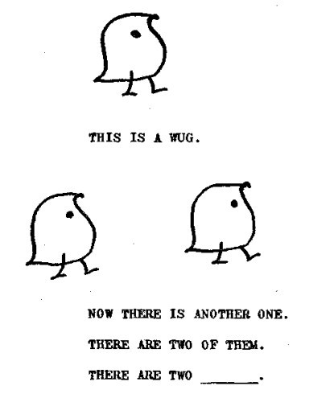
1. Productive usage
05 - Morphological representation and processing
Berko-Gleason’s ‘Wug test’
Nick Riches
Introduction
The big debate
Comp. versus Lex.
Evidence for comp. sys.
Productive usage
Morph errors
Morpho-phon. parsing
Phonotactic evidence
Whole-wd. storage
Non-word roots
Multiple meanings
Psycholinguistic evidence
A hybrid view
Evidence for 2 sys. Gradient phenomena
Dual Route Model
Proc. vs. Decl. The model Evidence
Crit. of DR model
Pseudo-regularity
The role of frequency
5-minute exercise
Bib
6 / 30

Slide 10
2. Morphological movement, stranding and substitution errors
05 - Morphological representation and processing
Nick Riches
Introduction
The big debate
Comp. versus Lex.
Evidence for comp. sys.
Productive usage
Morph errors
Morpho-phon. parsing
Phonotactic evidence
She wash upp-ed the dishes.
I’d forgot about-en that
We have a lot of church-es in our minister
She always pack-s a keep
He gave me some good de-vice
Whole-wd. storage
Non-word roots
Multiple meanings
Psycholinguistic evidence
A hybrid view
Evidence for 2 sys. Gradient phenomena
Dual Route Model
Proc. vs. Decl.
The model Evidence
Crit. of DR model
(1) Pseudo-regularity
(2) The role of frequency
5-minute exercise
Bib
7 / 30

Slide 11
3. Morpho-phonological parsing (Post et al. 2008)
05 - Morphological representation and processing
Nick Riches
Introduction
The big debate
Comp. versus Lex.
Speeded same / different judgement with male and female voices
Evidence for comp. sys.
Productive usage
Morph errors
Morpho-phon. parsing
Phonotactic evidence
Type
Example RT
Whole-wd. storage
Non-word roots
Multiple meanings
Psycholinguistic evidence
Real infl. Pseudo infl. Novel infl. No infl.
Filled-fill Mild-mile Nilled-nill Belt-bell
A hybrid view
Evidence for 2 sys. Gradient phenomena
Dual Route Model
Proc. vs. Decl.
The model Evidence
Crit. of DR model
(1) Pseudo-regularity
(2) The role of frequency
5-minute exercise
Bib
8 / 30

Slide 12
3. Morpho-phonological parsing (Post et al. 2008)
05 - Morphological representation and processing
Nick Riches
Introduction
The big debate
Comp. versus Lex.
Speeded same / different judgement with male and female voices
Evidence for comp. sys.
Productive usage
Morph errors
Morpho-phon. parsing
Phonotactic evidence
Type | Example | RT
Real infl. Pseudo infl. Novel infl. No infl. | Filled-fill Mild-mile Nilled-nill Belt-bell | 949
Whole-wd. storage
Non-word roots
Multiple meanings
Psycholinguistic evidence
A hybrid view
Evidence for 2 sys. Gradient phenomena
Dual Route Model
Proc. vs. Decl.
The model Evidence
Crit. of DR model
(1) Pseudo-regularity
(2) The role of frequency
5-minute exercise
Bib
8 / 30

Slide 13
3. Morpho-phonological parsing (Post et al. 2008)
05 - Morphological representation and processing
Nick Riches
Introduction
The big debate
Comp. versus Lex.
Speeded same / different judgement with male and female voices
Evidence for comp. sys.
Productive usage
Morph errors
Morpho-phon. parsing
Phonotactic evidence
Type | Example | RT
Real infl. | Filled-fill | 949
Pseudo infl. Novel infl. No infl. | Mild-mile Nilled-nill Belt-bell | 932
Whole-wd. storage
Non-word roots
Multiple meanings
Psycholinguistic evidence
A hybrid view
Evidence for 2 sys. Gradient phenomena
Dual Route Model
Proc. vs. Decl.
The model Evidence
Crit. of DR model
(1) Pseudo-regularity
(2) The role of frequency
5-minute exercise
Bib
8 / 30

Slide 14
3. Morpho-phonological parsing (Post et al. 2008)
05 - Morphological representation and processing
Nick Riches
Introduction
The big debate
Comp. versus Lex.
Speeded same / different judgement with male and female voices
Evidence for comp. sys.
Productive usage
Morph errors
Morpho-phon. parsing
Phonotactic evidence
Type | Example | RT
Real infl. | Filled-fill | 949
Pseudo infl. | Mild-mile | 932
Novel infl. No infl. | Nilled-nill Belt-bell | 908
Whole-wd. storage
Non-word roots
Multiple meanings
Psycholinguistic evidence
A hybrid view
Evidence for 2 sys. Gradient phenomena
Dual Route Model
Proc. vs. Decl.
The model Evidence
Crit. of DR model
(1) Pseudo-regularity
(2) The role of frequency
5-minute exercise
Bib
8 / 30

Slide 15
3. Morpho-phonological parsing (Post et al. 2008)
05 - Morphological representation and processing
Nick Riches
Introduction
The big debate
Comp. versus Lex.
Speeded same / different judgement with male and female voices
Evidence for comp. sys.
Productive usage
Morph errors
Morpho-phon. parsing
Phonotactic evidence
Type | Example | RT
Real infl. | Filled-fill | 949
Pseudo infl. | Mild-mile | 932
Novel infl. | Nilled-nill | 908
Whole-wd. storage
Non-word roots
Multiple meanings
Psycholinguistic evidence
A hybrid view
Evidence for 2 sys. Gradient phenomena
No infl.
Belt-bell
806
Dual Route Model
Proc. vs. Decl. The model Evidence
Crit. of DR model
(1) Pseudo-regularity
(2) The role of frequency
5-minute exercise
Bib
8 / 30

Slide 16
3. Morpho-phonological parsing (Post et al. 2008)
05 - Morphological representation and processing
Nick Riches
Introduction
The big debate
Comp. versus Lex.
Evidence for comp. sys.
Productive usage
Morph errors
Morpho-phon. parsing
Phonotactic evidence
Whole-wd. storage
Non-word roots
Multiple meanings
Psycholinguistic evidence
A hybrid view
Evidence for 2 sys. Gradient phenomena
Computational |  |  | Whole-entry
fill- miss fill- book | /d/ -ed | shelf | filled | untie book shelf
Dual Route Model
Proc. vs. Decl. The model Evidence
Crit. of DR model
(1) Pseudo-regularity
(2) The role of frequency
5-minute exercise
Bib
9 / 30

Slide 17
3. Morpho-phonological parsing (Post et al. 2008)
05 - Morphological representation and processing
Nick Riches
Introduction
The big debate
Comp. versus Lex.
Evidence for comp. sys.
Productive usage
Morph errors
Morpho-phon. parsing
Phonotactic evidence
Whole-wd. storage
Non-word roots
Multiple meanings
Psycholinguistic evidence
A hybrid view
Evidence for 2 sys. Gradient phenomena
Dual Route Model
Proc. vs. Decl. The model Evidence
Crit. of DR model
Pseudo-regularity
The role of frequency
5-minute exercise
Computational |  |  | Whole-entry
mile miss mile book | /d/ -ed | mild shelf | filled | untie book shelf
Bib
9 / 30

Slide 18
3. Morpho-phonological parsing (Post et al. 2008)
05 - Morphological representation and processing
Nick Riches
Introduction
The big debate
Comp. versus Lex.
Evidence for comp. sys.
Productive usage
Morph errors
Morpho-phon. parsing
Phonotactic evidence
Whole-wd. storage
Non-word roots
Multiple meanings
Psycholinguistic evidence
A hybrid view
Evidence for 2 sys. Gradient phenomena
Dual Route Model
Proc. vs. Decl. The model Evidence
Crit. of DR model
Pseudo-regularity
The role of frequency
5-minute exercise
Computational |  |  | Whole-entry
belt fill belt book | -ed | shelf | filled | untie book shelf
Bib
9 / 30

Slide 19
4. Phonotactic evidence
05 - Morphological representation and processing
Nick Riches
Introduction The big debate
Comp. versus Lex.
Evidence for comp. sys.
Productive usage
Morph errors
Morpho-phon. parsing
Phonotactic evidence
lost → frost, accost, riposte swam → dam, tram, ham
turned → spurn-ed, learn-ed, earn-ed
Whole-wd. storage
Non-word roots
Multiple meanings
Psycholinguistic evidence
A hybrid view
Evidence for 2 sys. Gradient phenomena
Dual Route Model
Proc. vs. Decl. The model Evidence
Crit. of DR model
(1) Pseudo-regularity
(2) The role of frequency
5-minute exercise
Bib
10 / 30

Slide 20
05 - Morphological representation and processing
Introduction
Nick Riches
Introduction
The big debate
The big debate
Comp. versus Lex.
Evidence for a computational system
Evidence for comp. sys.
Productive usage
Morph errors
Morpho-phon. parsing
Phonotactic evidence
Evidence of the whole-word storage of morphologically-complex words
Whole-wd. storage
Non-word roots
Multiple meanings
Psycholinguistic evidence
A hybrid view
Morphology in language impairments - Ullman and Pinker’s Dual Route model
5-minute exercise Bibliography
A hybrid view
Evidence for 2 sys. Gradient phenomena
Dual Route Model
Proc. vs. Decl. The model Evidence
Crit. of DR model
(1) Pseudo-regularity
(2) The role of frequency
5-minute exercise
Bib
10 / 30

Slide 21
1. Non-word roots
05 - Morphological representation and processing
Nick Riches
Introduction The big debate
Comp. versus Lex.
Evidence for comp. sys.
Productive usage
Morph errors
Morpho-phon. parsing
Phonotactic evidence
Un-re-mitt-ing-ly
It’s in-evit-able
The food supplies were de-plet-ed
Whole-wd. storage
Non-word roots
Multiple meanings
Psycholinguistic evidence
A hybrid view
Evidence for 2 sys. Gradient phenomena
Dual Route Model
Proc. vs. Decl. The model
Evidence
Crit. of DR model
(1) Pseudo-regularity
(2) The role of frequency
5-minute exercise
Bib
11 / 30

Slide 22
2. Multiple meanings
05 - Morphological representation and processing
Nick Riches
Introduction The big debate
Comp. versus Lex.
Agent / instrument ambiguity Stripper
Gardener Cooker
Evidence for comp. sys.
Productive usage
Morph errors
Morpho-phon. parsing
Phonotactic evidence
Whole-wd. storage
Non-word roots
Multiple meanings
Psycholinguistic evidence
A hybrid view
Evidence for 2 sys. Gradient phenomena
Dual Route Model
Proc. vs. Decl. The model Evidence
Crit. of DR model
Pseudo-regularity
The role of frequency
5-minute exercise
Bib
12 / 30

Slide 23
3. Psycholinguistic evidence
05 - Morphological representation and processing
Nick Riches
Losiewicz (1995) laps−→ lapse→ hovered−→ covered→ kneaded−→ needed→
Introduction
The big debate
Comp. versus Lex.
Evidence for comp. sys.
Productive usage
Morph errors
Morpho-phon. parsing
Phonotactic evidence
Whole-wd. storage
Non-word roots
Multiple meanings
Psycholinguistic evidence
A hybrid view
Evidence for 2 sys. Gradient phenomena
Dual Route Model
Proc. vs. Decl.
The model
Evidence
Crit. of DR model
(1) Pseudo-regularity
(2) The role of frequency
5-minute exercise
Bib
13 / 30

Slide 24
3. Psycholinguistic evidence
05 - Morphological representation and processing
Nick Riches
Losiewicz (1995) laps−→ lapse→ hovered−→ covered→ kneaded−→ needed→
Alegre & Gordon (1999)
Relation between speed of lexicality judgement and frequency of inflected form only when inflected form exceeds a specific frequency threshold (1 word per 7 million)
Introduction
The big debate
Comp. versus Lex.
Evidence for comp. sys.
Productive usage
Morph errors
Morpho-phon. parsing
Phonotactic evidence
Whole-wd. storage
Non-word roots
Multiple meanings
Psycholinguistic evidence
A hybrid view
Evidence for 2 sys. Gradient phenomena
Dual Route Model
Proc. vs. Decl.
The model
Evidence
Crit. of DR model
(1) Pseudo-regularity
(2) The role of frequency
5-minute exercise
Bib
13 / 30

Slide 25
05 - Morphological representation and processing
Introduction
Nick Riches
Introduction
The big debate
The big debate
Comp. versus Lex.
Evidence for a computational system
Evidence for comp. sys.
Productive usage
Morph errors
Morpho-phon. parsing
Phonotactic evidence
Evidence of the whole-word storage of morphologically-complex words
Whole-wd. storage
Non-word roots
Multiple meanings
Psycholinguistic evidence
A hybrid view
Morphology in language impairments - Ullman and Pinker’s Dual Route model
5-minute exercise Bibliography
A hybrid view
Evidence for 2 sys. Gradient phenomena
Dual Route Model
Proc. vs. Decl. The model Evidence
Crit. of DR model
(1) Pseudo-regularity
(2) The role of frequency
5-minute exercise
Bib
13 / 30

Slide 26
Strong evidence for two systems
05 - Morphological representation and processing
Nick Riches
Introduction The big debate
Comp. versus Lex.
Evidence for comp. sys.
Productive usage
Morph errors
Morpho-phon. parsing
Phonotactic evidence
Novel inflected forms, e.g. meek-ed
Non-word roots, e.g. un-remitt-ing-ly
Whole-wd. storage
Non-word roots
Multiple meanings
Psycholinguistic evidence
A hybrid view
Evidence for 2 sys. Gradient phenomena
Dual Route Model
Proc. vs. Decl. The model
Evidence
Crit. of DR model
(1) Pseudo-regularity
(2) The role of frequency
5-minute exercise
Bib
14 / 30

Slide 27
Strong evidence for two systems
05 - Morphological representation and processing
Nick Riches
Introduction The big debate
Comp. versus Lex.
Evidence for comp. sys.
Productive usage
Morph errors
Morpho-phon. parsing
Phonotactic evidence
processing ⇐ ⇒ expressivity
Whole-wd. storage
Non-word roots
Multiple meanings
Psycholinguistic evidence
A hybrid view
Evidence for 2 sys. Gradient phenomena
Dual Route Model
Proc. vs. Decl. The model Evidence
Crit. of DR model
Pseudo-regularity
The role of frequency
5-minute exercise
Bib
15 / 30

Slide 28
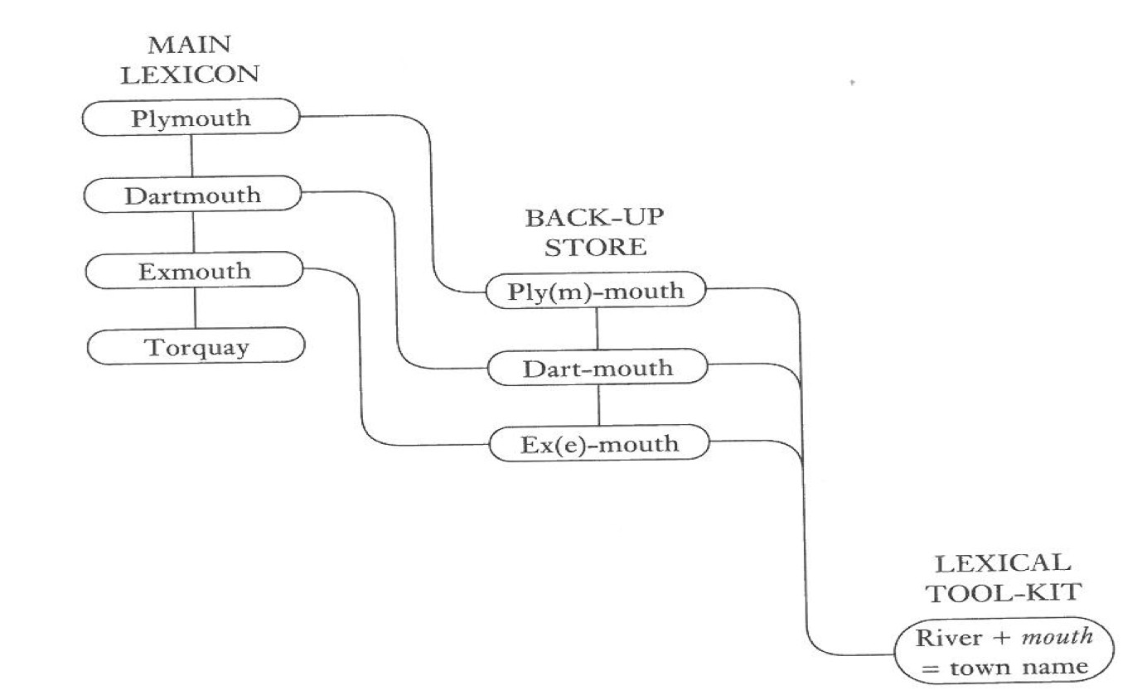
Gradient phenomena
05 - Morphological representation and processing
Nick Riches
Aitchison, ‘Words in the Mind’ (2002)
Introduction
The big debate
Comp. versus Lex.
Evidence for comp. sys.
Productive usage
Morph errors
Morpho-phon. parsing
Phonotactic evidence
Whole-wd. storage
Non-word roots
Multiple meanings
Psycholinguistic evidence
A hybrid view
Evidence for 2 sys. Gradient phenomena
Dual Route Model
Proc. vs. Decl. The model Evidence
Crit. of DR model
Pseudo-regularity
The role of frequency
5-minute exercise
Bib
16 / 30

Slide 29
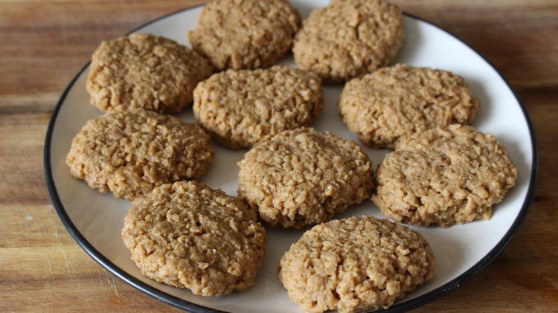
Gradient phenomena
05 - Morphological representation and processing
Nick Riches
Introduction
Chickenless nuggets ⇒
The big debate
Comp. versus Lex.
A careless person ⇒
A gormless/ruthless person
Evidence for comp. sys.
Productive usage
Morph errors
Morpho-phon. parsing
Phonotactic evidence
Whole-wd. storage
Non-word roots
Multiple meanings
Psycholinguistic evidence
A hybrid view
Evidence for 2 sys. Gradient phenomena
Dual Route Model
Proc. vs. Decl. The model Evidence
Crit. of DR model
(1) Pseudo-regularity
(2) The role of frequency
5-minute exercise
Bib
17 / 30

Slide 30
05 - Morphological representation and processing
Introduction
Nick Riches
Introduction
The big debate
The big debate
Comp. versus Lex.
Evidence for a computational system
Evidence for comp. sys.
Productive usage
Morph errors
Morpho-phon. parsing
Phonotactic evidence
Evidence of the whole-word storage of morphologically-complex words
Whole-wd. storage
Non-word roots
Multiple meanings
Psycholinguistic evidence
A hybrid view
Morphology in language impairments - Ullman and Pinker’s Dual Route model
5-minute exercise Bibliography
A hybrid view
Evidence for 2 sys. Gradient phenomena
Dual Route Model
Proc. vs. Decl. The model Evidence
Crit. of DR model
(1) Pseudo-regularity
(2) The role of frequency
5-minute exercise
Bib
17 / 30

Slide 31
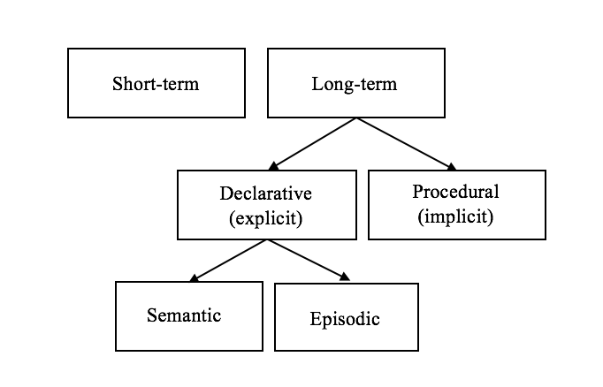
Procedural versus Declarative memory
05 - Morphological representation and processing
Nick Riches
Tulving’s Memory model
Introduction
The big debate
Comp. versus Lex.
Evidence for comp. sys.
Productive usage
Morph errors
Morpho-phon. parsing
Phonotactic evidence
Whole-wd. storage
Non-word roots
Multiple meanings
Psycholinguistic evidence
A hybrid view
Evidence for 2 sys. Gradient phenomena
Dual Route Model
Proc. vs. Decl. The model
Evidence
Crit. of DR model
(1) Pseudo-regularity
(2) The role of frequency
5-minute exercise
Bib
18 / 30

Slide 32
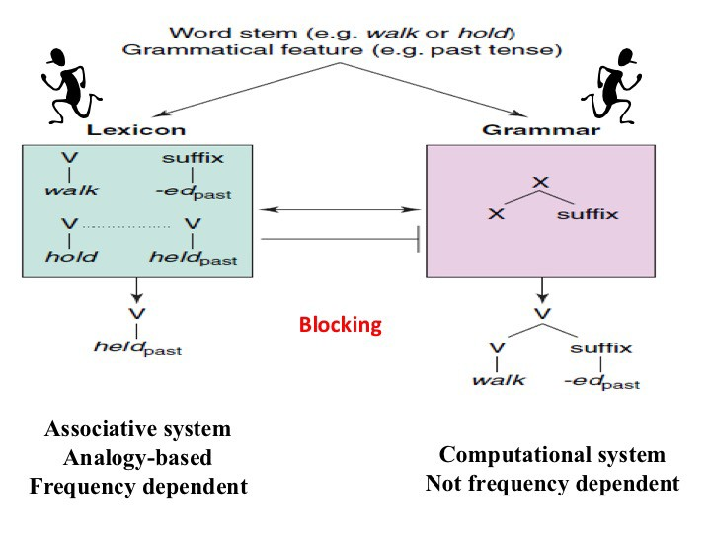
The model
05 - Morphological representation and processing
Nick Riches
Introduction The big debate
Comp. versus Lex.
Evidence for comp. sys.
Productive usage
Morph errors
Morpho-phon. parsing
Phonotactic evidence
Whole-wd. storage
Non-word roots
Multiple meanings
Psycholinguistic evidence
A hybrid view
Evidence for 2 sys. Gradient phenomena
Dual Route Model
Proc. vs. Decl.
The model
Evidence
Crit. of DR model
(1) Pseudo-regularity
(2) The role of frequency
5-minute exercise
Bib
19 / 30

Slide 33
Evidence
05 - Morphological representation and processing
Nick Riches
Introduction
Pinker & Ullman (2002) - Frequency effects are only found in the irregular system
The big debate
Comp. versus Lex.
Evidence for comp. sys.
Productive usage
Morph errors
Morpho-phon. parsing
Phonotactic evidence
1. Children’s overregularisation errors, e.g. she swammed are determined by the density of the irregular neighbourhood
e.g. [ swim → swam, sing → sang ] versus
[ bring → brought, buy → bought, seek → sought, teach → taught, fight → fought ]
2. Adult generation of inflected form is affected by input frequency only in the irregular system.
Whole-wd. storage
Non-word roots
Multiple meanings
Psycholinguistic evidence
A hybrid view
Evidence for 2 sys. Gradient phenomena
Dual Route Model
Proc. vs. Decl.
The model
Evidence
Crit. of DR model
(1) Pseudo-regularity
(2) The role of frequency
5-minute exercise
Bib
20 / 30

Slide 34
Evidence
05 - Morphological representation and processing
Nick Riches
Analogy = the mapping of relationships What is the past tense of tring ?
Introduction
The big debate
Comp. versus Lex.
Evidence for comp. sys.
Productive usage
Morph errors
Morpho-phon. parsing
Phonotactic evidence
Whole-wd. storage
Non-word roots
Multiple meanings
Psycholinguistic evidence
A hybrid view
Evidence for 2 sys. Gradient phenomena
Dual Route Model
Proc. vs. Decl.
The model Evidence
Crit. of DR model
(1) Pseudo-regularity
(2) The role of frequency
5-minute exercise
Bib
21 / 30

Slide 35
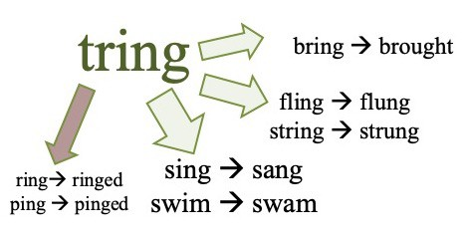
Evidence
05 - Morphological representation and processing
Nick Riches
Analogy = the mapping of relationships What is the past tense of tring ?
Introduction
The big debate
Comp. versus Lex.
Evidence for comp. sys.
Productive usage
Morph errors
Morpho-phon. parsing
Phonotactic evidence
Whole-wd. storage
Non-word roots
Multiple meanings
Psycholinguistic evidence
A hybrid view
Evidence for 2 sys. Gradient phenomena
Dual Route Model
Proc. vs. Decl. The model Evidence
Crit. of DR model
Pseudo-regularity
The role of frequency
5-minute exercise
Bib
21 / 30

Slide 36
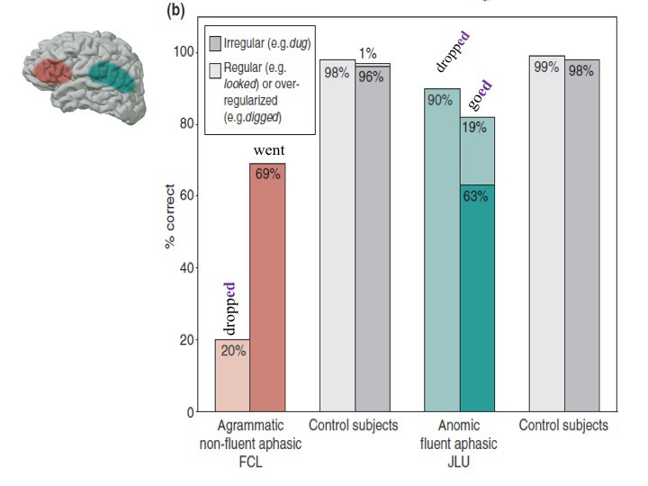
Evidence
05 - Morphological representation and processing
Nick Riches
Introduction The big debate
Comp. versus Lex.
Evidence for comp. sys.
Productive usage
Morph errors
Morpho-phon. parsing
Phonotactic evidence
Whole-wd. storage
Non-word roots
Multiple meanings
Psycholinguistic evidence
A hybrid view
Evidence for 2 sys. Gradient phenomena
Dual Route Model
Proc. vs. Decl. The model Evidence
Crit. of DR model
Pseudo-regularity
The role of frequency
5-minute exercise
Bib
22 / 30

Slide 37
Evidence
05 - Morphological representation and processing
Nick Riches
Introduction The big debate
Comp. versus Lex.
Evidence for comp. sys.
Productive usage
Morph errors
Morpho-phon. parsing
Phonotactic evidence
Procedural memory affected
Declarative memory affected
IRREG. >better than >REG.
REG. >better than >IRREG.
Whole-wd. storage
Non-word roots
Multiple meanings
Psycholinguistic evidence
Dev. Lang. Disorder Parkinsons
Broca’s type aphasia
Alzheimmers Wernicke’s type aphasia
A hybrid view
Evidence for 2 sys. Gradient phenomena
Dual Route Model
Proc. vs. Decl. The model Evidence
Crit. of DR model
Pseudo-regularity
The role of frequency
5-minute exercise
Bib
23 / 30

Slide 38
Evidence
05 - Morphological representation and processing
Nick Riches
Introduction The big debate
Comp. versus Lex.
Evidence for comp. sys.
Productive usage
Morph errors
Morpho-phon. parsing
Phonotactic evidence
Whole-wd. storage
Non-word roots
Multiple meanings
Psycholinguistic evidence
A hybrid view
Evidence for 2 sys. Gradient phenomena
Dual Route Model
Proc. vs. Decl. The model Evidence
Crit. of DR model
Pseudo-regularity
The role of frequency
5-minute exercise
Bib
24 / 30

Slide 39
Evidence
05 - Morphological representation and processing
Nick Riches
Introduction The big debate
Comp. versus Lex.
Evidence for comp. sys.
Productive usage
Morph errors
Morpho-phon. parsing
Phonotactic evidence
Whole-wd. storage
Non-word roots
Multiple meanings
Psycholinguistic evidence
A hybrid view
Evidence for 2 sys. Gradient phenomena
Dual Route Model
Proc. vs. Decl. The model Evidence
Crit. of DR model
Pseudo-regularity
The role of frequency
5-minute exercise
Bib
25 / 30

Slide 40
Criticism of the dual route model
05 - Morphological representation and processing
Nick Riches
Introduction The big debate
Comp. versus Lex.
Joanisse & Seidenberg, 1999.
Irregular system shows characteristics of regular system meet → met, let → let, put → put, shut → shut goose → geese, mouse → mice, moose → moose.
Evidence for comp. sys.
Productive usage
Morph errors
Morpho-phon. parsing
Phonotactic evidence
Whole-wd. storage
Non-word roots
Multiple meanings
Psycholinguistic evidence
A hybrid view
Evidence for 2 sys. Gradient phenomena
Dual Route Model
Proc. vs. Decl. The model Evidence
Crit. of DR model
Pseudo-regularity
The role of frequency
5-minute exercise
Bib
26 / 30

Slide 41
Criticism of the dual route model
05 - Morphological representation and processing
Nick Riches
Introduction The big debate
Comp. versus Lex.
Evidence for comp. sys.
Productive usage
Morph errors
Morpho-phon. parsing
Phonotactic evidence
Frequency does play a role in regular morphology.
e.g. Losiewicz and Alegre & Gordon studies cited above
Whole-wd. storage
Non-word roots
Multiple meanings
Psycholinguistic evidence
A hybrid view
Evidence for 2 sys. Gradient phenomena
Dual Route Model
Proc. vs. Decl. The model Evidence
Crit. of DR model
Pseudo-regularity
The role of frequency
5-minute exercise
Bib
27 / 30

Slide 42
Criticism of the dual route model
05 - Morphological representation and processing
Nick Riches
Introduction The big debate
Comp. versus Lex.
Evidence for comp. sys.
Productive usage
Morph errors
Morpho-phon. parsing
Phonotactic evidence
Whole-wd. storage
Non-word roots
Multiple meanings
Psycholinguistic evidence
A hybrid view
Evidence for 2 sys. Gradient phenomena
Dual Route Model
Proc. vs. Decl. The model Evidence
Crit. of DR model
(1) Pseudo-regularity
(2) The role of frequency
5-minute exercise
Bib
28 / 30

Slide 43
05 - Morphological representation and processing
Introduction
Nick Riches
Introduction
The big debate
The big debate
Comp. versus Lex.
Evidence for a computational system
Evidence for comp. sys.
Productive usage
Morph errors
Morpho-phon. parsing
Phonotactic evidence
Evidence of the whole-word storage of morphologically-complex words
Whole-wd. storage
Non-word roots
Multiple meanings
Psycholinguistic evidence
A hybrid view
Morphology in language impairments - Ullman and Pinker’s Dual Route model
5-minute exercise Bibliography
A hybrid view
Evidence for 2 sys. Gradient phenomena
Dual Route Model
Proc. vs. Decl. The model Evidence
Crit. of DR model
(1) Pseudo-regularity
(2) The role of frequency
5-minute exercise
Bib
28 / 30

Slide 44
05 - Morphological representation and processing
Nick Riches
Introduction The big debate
Comp. versus Lex.
Which one of these sentences did Yoda say in the Star Wars trilogy? Can you explain the reasons behind your choice?
Evidence for comp. sys.
Productive usage
Morph errors
Morpho-phon. parsing
Phonotactic evidence
Have become powerful you. You the dark side I sense in.
Powerful you have become. The dark side I sense in you.
Become powerful you have. The dark I sense in you side.
Whole-wd. storage
Non-word roots
Multiple meanings
Psycholinguistic evidence
A hybrid view
Evidence for 2 sys. Gradient phenomena
Dual Route Model
Proc. vs. Decl. The model
Evidence
Crit. of DR model
(1) Pseudo-regularity
(2) The role of frequency
5-minute exercise
Bib
29 / 30

Slide 45
05 - Morphological representation and processing
Introduction
Nick Riches
Introduction
The big debate
The big debate
Comp. versus Lex.
Evidence for a computational system
Evidence for comp. sys.
Productive usage
Morph errors
Morpho-phon. parsing
Phonotactic evidence
Evidence of the whole-word storage of morphologically-complex words
Whole-wd. storage
Non-word roots
Multiple meanings
Psycholinguistic evidence
A hybrid view
Morphology in language impairments - Ullman and Pinker’s Dual Route model
5-minute exercise Bibliography
A hybrid view
Evidence for 2 sys. Gradient phenomena
Dual Route Model
Proc. vs. Decl. The model Evidence
Crit. of DR model
(1) Pseudo-regularity
(2) The role of frequency
5-minute exercise
Bib
29 / 30

Slide 46
05 - Morphological representation and processing
Nick Riches
Introduction
Aitchison, J. (2002). Words in the Mind: An Introduction to the Mental Lexicon (3rd Edition). Wiley-Blackwell.
The big debate
Comp. versus Lex.
Alegre, M., & Gordon, P. (1999). Frequency effects and the representational status of regular inflections. Journal of Memory and Language, 40, 41–61.
Evidence for comp. sys.
Productive usage
Morph errors
Morpho-phon. parsing
Phonotactic evidence
Joanisse, M. F., & Seidenberg, M. S. (1999). Impairments in verb morphology after brain injury: A connectionist model. Proceedings of the National Academy of Sciences of the United States of America, 96(13), 7592.
Losiewicz, B. L. (1992). The effect of frequency on linguistic morphology. University of Texas at Austin.
Whole-wd. storage
Non-word roots
Multiple meanings
Psycholinguistic evidence
Pinker, S., & Ullman, M. T. (2002). The past and future of the past tense debate. Trends in Cognitive Sciences, 6(11), 456–463.
Post, B., Marslen-Wilson, W. D., Randall, B., & Tyler, L. K. (2008). The processing of English regular inflections: Phonological cues to morphological structure. Cognition, 109(1), 1–17. https://doi.org/10.1016/j.cognition.2008.06.011
A hybrid view
Evidence for 2 sys. Gradient phenomena
Ullman, M. T., & Pierpont, E. I. (2005). Specific language impairment is not specific to language: the procedural deficit hypothesis. Cortex, 41(3), 399–433.
Dual Route Model
Proc. vs. Decl. The model
Evidence
Crit. of DR model
(1) Pseudo-regularity
(2) The role of frequency
5-minute exercise
Bib
30 / 30

